Slide 1

Spam Mail Prediction
-Machine Learning Projects
-Logistic Regression

Slide 2

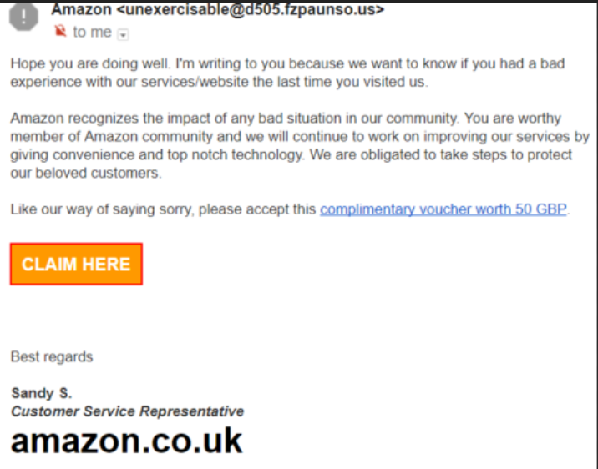
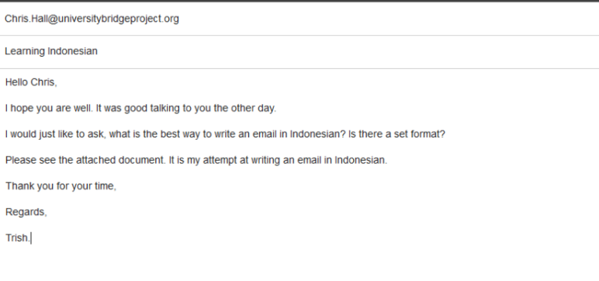

Slide 3
